Slide 1
Chapter 2
Database System Concepts and Architecture

Slide 2
Chapter 2 Outline
Data Models, Schemas, and Instances
Three-Schema Architecture and Data Independence
Database Languages and Interfaces
The Database System Environment
Centralized and Client/Server Architectures
for DBMSs
Classification of Database Management Systems

Slide 3
Database System Concepts and Architecture
Basic client/server DBMS architecture
  Client module
  Server module
  Research… what is client/server module , what is its relation with database ?????
  For next lecture

Slide 4
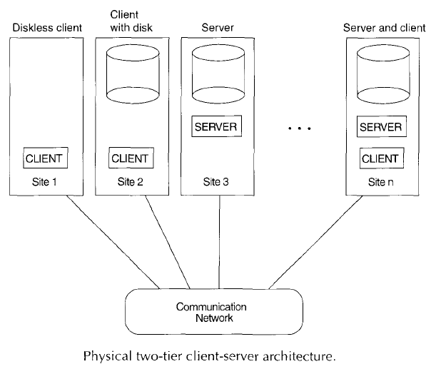

Slide 5
Data Models, Schemas, and Instances
Data abstraction
  Suppression of details of data organization and storage
  Highlighting of the essential features for an improved understanding of data
  يعطيك صورة عن البيانات بشكل مجرد و يخفي عنك التفاصيل غير اللازمة (التي لا تهمك)--- تخيل تخزين المصفوفة في الذاكرة الفعلية.
  ما يهمني أن أجد الجدول موجود بكل بياناته التي تخصني بدون معرفة مكان تخزينه

Slide 6
Data Models, Schemas, and Instances (cont'd.)
Data modelتستخدم لتحقيق مفهوم تجريد البيانات (عادة رسومات كروكي /مخططات)
  Collection of concepts that describe the structure of a databaseمجموعة مفاهيم تستخدم لوصف هيكلية قاعدة البيانات
  Structure = data type ,relationships and constraints
  Provides means to achieve data abstraction
  Data model includes :تحتوي على بعض الادوات تشمل
  Basic operations العمليات الممكن تطبيقها على الجداول
    Specify retrievals and updates on the database
  Dynamic aspect or behavior of a database application
    Allows the database designer to specify a set of valid operations allowed on database objects

Slide 7
Categories of Data Models according to the types of concepts they use to describe the DB structure
High-level or conceptual data models
  Close to the way many users perceive dataبدون تفاصيل
Low-level or physical data models
  Describe the details of how data is stored on computer storage mediaعادة للمختصين و ليس للمستخدم العادي
Representational data modelsوسيط بين النوعين السابقين
  Easily understood by end users
  Also similar to how data organized in computer storage
  يطلعك على الشكل العام لتخزين البيانات

Slide 8
Categories of Data Models (cont’d.)
Conceptual data models use concepts such as Entity, Attribute and relationships
Entity
  Represents a real-world object or concept
  Employee , student , project….
Attribute
  Represents some property of interest
  Further describes an entity
  . stName, StNo,…

Slide 9

Categories of Data Models (cont'd.)
Relationship among two or more entities
  Represents an association among the entities
  Entity-Relationship model
Ex: Students study a course
EX2 : customer deposits on the account

Slide 10
Categories of Data Models (cont’d.)
Representational Data Models use:
Relational data model
  Used most frequently in traditional commercial DBMSsيعطيك أسماء الجداول و أسماء الاعمدة التي تحتويها و العلاقة بين هذه الجداول (صورة للبيانات وهي مخزنة )
Object data model
  New family of higher-level implementation data models
  Closer to conceptual data models

Slide 11
Categories of Data Models (cont'd.)
Physical data models
  Describe how data is stored as files in the computer
  Access path
    Structure that makes the search for particular database records efficient الخطوات"الطريق" المتبعة لاحضار البيانات من قاعدة البيانات
  Index
    Example of an access path
    Allows direct access to data using an index term or a keywordفهرس يساعد للوصول مباشرة للبيانات مثل فهرس الكتب

Slide 12
Schemas, Instances, and Database State
Database schema
  Is a Description of a database(not the Db itself)
  يتم انشاؤها في مرحلة DB Design أي في البداية
Schema diagram في حال استخدام رسمة للتعبير عن البيانات
  Displays selected aspects of schema
Schema construct
  Each object in the schema
Database state or snapshot
  Data in database at a particular moment in time
  البيانات الحقيقية في لحظة ما , ممكن البيانات يحدث عليها تغيير أي لحظة أثناء عمليات التحديث فتصبح snapshot جديد (بعد التعديل)

Slide 13
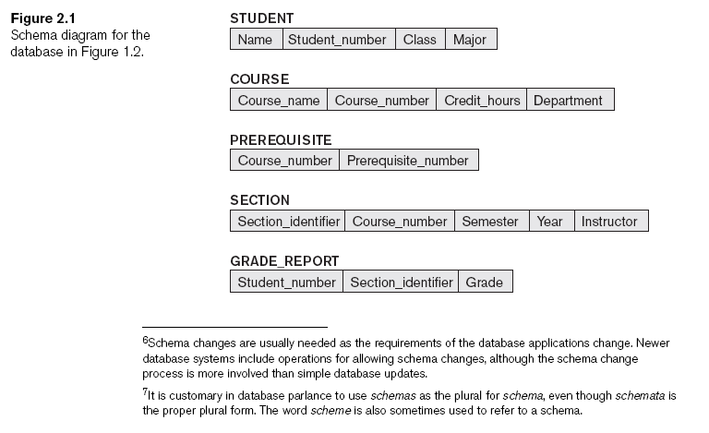
Schemas, Instances, and Database State (cont'd.)

Slide 14
Schemas, Instances, and Database State (cont'd.)
Define a new database
  Specify database schema to the DBMS
  تحديد مخطط قواعد بيانات
Initial state الحالة الأولية للمخطط(هيكلية)
  Populated or loaded with the initial data
Valid state
  Satisfies the structure and constraints specified in the schemaمخطط للهيكلية و القيود الخاصة بقاعدة البيانات

Slide 15
Schemas, Instances, and Database State (cont'd.)
Schema evolution
  Changes applied to schema as application requirements change

Slide 16
Three-Schema Architecture and Data Independence
The goal of the three-schema architecture is to separate the user applications from the physical database. In this architecture , schemas can be defined at the following three levels :
Internal level
Conceptual level
External or view level

Slide 17
Three-Schema Architecture and Data Independence (cont'd.)
Internal level
  Describes physical storage structure of the database. Uses the physical data model and describes the complete details of data storage and access paths for the database
Conceptual level
  Describes structure of the whole database for a community of users ,it hides the details of physical storage , and concentrates on describing entities , data types, relationships ,user operations and constraints
External or view level يخص المستخدم النهائي
  Describes part of the database that a particular user group is interested in

Slide 18
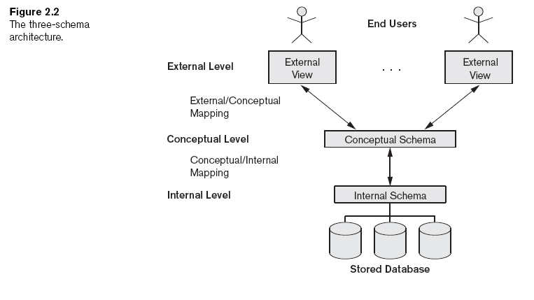
Three-Schema Architecture and Data Independence (cont'd.)

Slide 19
Data Independence
Capacity to change the schema at one level of a database system
  Without having to change the schema at the next higher level
  تتيح امكانية تعديل schema في level دون الاضرار لتعديلها في ال higher level
  مثلا : في حال توزيع البيانات الموجودة في سيرفر/قرص على أكثر من سيرفر/قرص (تعديل في ال internal ) لا يتطلب مني اجراء تعديلات على ال Conceptual level
Types:
  Logical
  Physical

Slide 20
Data Independence (cont’d)
Types:
  Logical: Capacity to change the conceptual schema without having to change external schemas or application program
  Give example of logical Data independence ?
  By adding/removing a record type or data item
  Physical: Capacity to change the internal schema without having to change conceptual schemas.
  Ex : reorganized physical files … creating additional access structure

Slide 21
DBMS Languages
Data definition language (DDL)
  Defines both schemas
Storage definition language (SDL)
  Specifies the internal schema أوامر تهتم بالتخزين ...
View definition language (VDL) للتعامل مع البناء الخارجي
  Specifies user views/mappings to conceptual schema
Data manipulation language (DML)
  Allows retrieval, insertion, deletion, modification

Slide 22
DBMS Languages (cont'd.)
High-level or nonprocedural DML
  Can be used on its own to specify complex database operations concisely
  Set-at-a-time or set-oriented
Low-level or procedural DML
  Must be embedded in a general-purpose programming language
  Record-at-a-time

Slide 23
DBMS Interfaces
Menu-based interfaces for Web clients or browsing
Forms-based interfaces
Graphical user interfaces
Natural language interfaces
Speech input and output
Interfaces for parametric users مدخلي البيانات
Interfaces for the DBA

Slide 24
The Database System Environment
DBMS component modules
مقسمة الى components و لكل واحد منها وظيفة و عمل خاص به
  Buffer management
  A module to schedule disk read/write to increase DB performance.
  Stored data manager
  A module to controls access to DBMS information that stored on disk(DB and catalog)
  Interactive query interface
  يتم من خلالها كتابة الاوامر من قبل casual user
    Query compiler --- to compile querier , to find errors
    Query optimizer– finding best path to bring data from DB , by helping of catalog
  Precompiler
  يتعامل مع الاوامر المكتوبة بلغات البرمجة(جافا) يستخلص منها جمل DML و يرسلها ل DML compiler

Slide 25
The Database System Environment (cont'd.)
DBMS component modules (cont'd.)
  Runtime database processor
  هو المنفذ الفعلي لكل الأكواد و الذي يحضر النتيجة من قواعد البيانات
  System catalog
  Concurrency control system
  جزئية تسمح لأكثر من transaction للعمل في نفس الوقت دون حدوث مشاكل
  عادة في قواعد البيانات يتم تنفيذ عدة عمليات في نفس الوقت و على نفس الداتا
  Backup and recovery system
  يعمل على أخذ نسخ احتياطية , و استرجاعDB لوضعها السابق

Slide 26
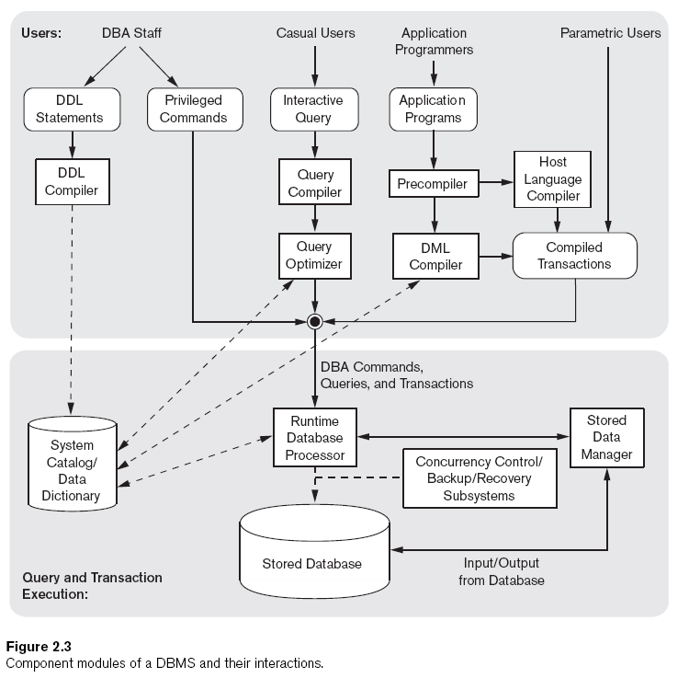

Slide 27
Database System Utilities
DB utilities helps DBA to manage DBMS
Functions of DB utilities :
Loading
  Load existing data files such as text files
  عملية نقل ملفات قديمة على ملفات قاعدة البيانات الجديدة حيث تساعد هذه الأداة على تحويل شكل البيانات الى مثيلها في قاعدة البيانات الجديدة
  old format(int) to new format(double)
Backup
  Creates a backup copy of the database

Slide 28
Database System Utilities (cont'd.)
Database storage reorganization
  Reorganize a set of database files into different file organizations
  تساعد في اعادة تنظيم تخزين البيانات في الملفات و تحديد paths جديدة
Performance monitoring
  Monitors database usage and provides statistics to the DBA
  تعمل ادارة/تحكم بقاعدة البيانات و تزود الأدمن ببعض الاحصائيات(حجم التحميل , تركيز العمليات على جهاز معين , ...

Slide 29
Tools, Application Environments, and Communications Facilities
CASE Toolsلاغي
Data dictionary (data repository) system
  Stores design decisions, usage standards, application program descriptions, and user information
Application development environments
Communications software

Slide 30
Centralized and Client/Server Architectures for DBMSs
Centralized DBMSs Architecture
  All DBMS functionality, application program execution, and user interface processing carried out on one machine
  Ex : mainframes and dummy monitors

Slide 31
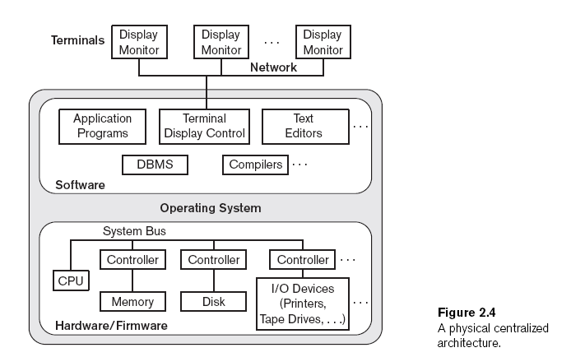

Slide 32
Basic Client/Server Architectures
Servers with specific functionalities
العمل موزع على سيرفرات لكل منها وظائف معينة
  File server
    Maintains the files of the client machines.
  Printer server
    Connected to various printers; all print requests by the clients are forwarded to this machine
  Web servers or e-mail servers

Slide 33
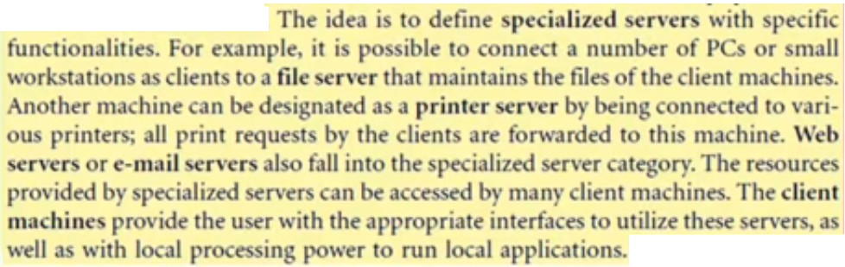
Basic Client/Server Architectures (cont'd.)

Slide 34
Basic Client/Server Architectures (cont'd.)
Client machines
  Provide user with:
    Appropriate interfaces to utilize these servers
    Local processing power to run local applications

Slide 35
Basic Client/Server Architectures (cont'd.)
Client
  User machine that provides user interface capabilities and local processing
Server
  System containing both hardware and software
  Provides services to the client machines
    Such as file access, printing, archiving, or database access

Slide 36
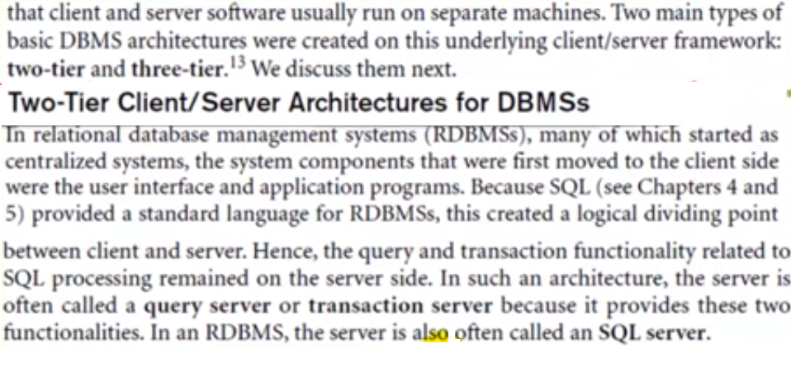

Slide 37
Two-Tier Client/Server Architectures for DBMSs
Server handles
  Query and transaction functionality related to SQL processing
Client handles
  User interface programs and application programs

Slide 38
Two-Tier Client/Server Architectures (cont'd.)
Open Database Connectivity (ODBC)
software تسمح باجراء الاتصال بين clinet/server , انتاج مايكروسوفت
  Provides application programming interface (API)
  Allows client-side programs to call the DBMS
    Both client and server machines must have the necessary software installed
JDBC
Software آخر نفس فكرة ال odbc
Allows Java client programs to access one or more DBMSs through a standard interface

Slide 39
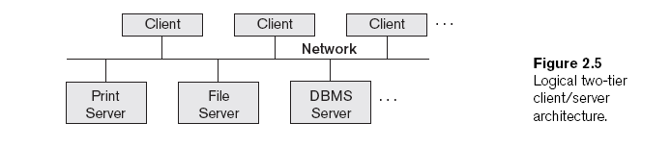
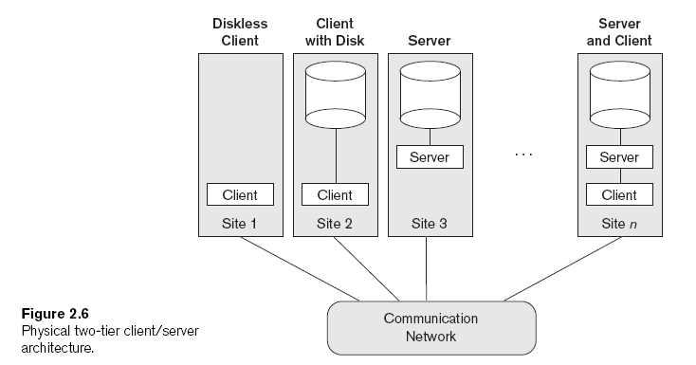

Slide 40
Three-Tier and n-Tier Architectures for Web Applications
Application server or Web serverاسمه
  Adds intermediate layer between client and the database server called Application server or Web server
  Runs application programs and stores business rules-→ (procedures or constraints )
  If we work on desktop App. We call it Application server , but if we work on web app we call it Web server
N-tier
  Divide the layers between the user and the stored data further into finer components

Slide 41
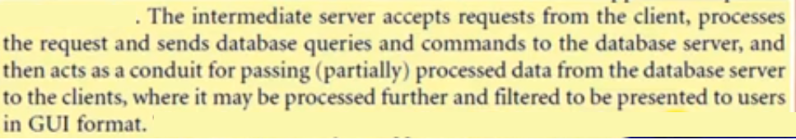

Slide 42
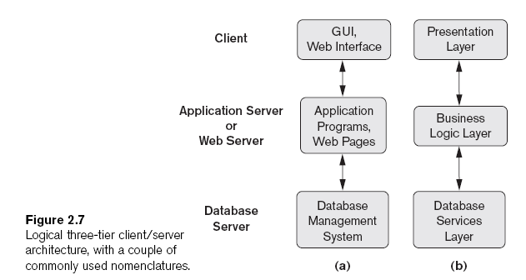

Slide 43
Classification of Database
Management Systems
Data model
  Relational
  Object
  Hierarchical and network (legacy)
  Native XML DBMS
Number of users
  Single-user
  Multiuser

Slide 44
Classification of Database
Management Systems (cont'd.)
Number of sites
  Centralized
  Distributed
    Homogeneous متماثل/متجانس
    Heterogeneous
Cost
  Open source
  Different types of licensing

Slide 45
Classification of Database
Management Systems (cont'd.)
Types of access path options
General or special-purpose

Slide 46
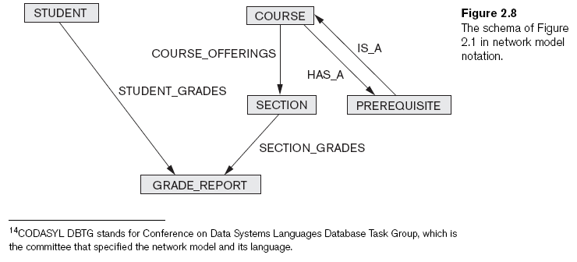
Classification of Database
Management Systems (cont'd.)

Slide 47
Summary
Concepts used in database systems
Main categories of data models
Types of languages supported by DMBSs
Interfaces provided by the DBMS
DBMS classification criteria:
  Data model, number of users, number of sties, access paths, cost

